Slide 1
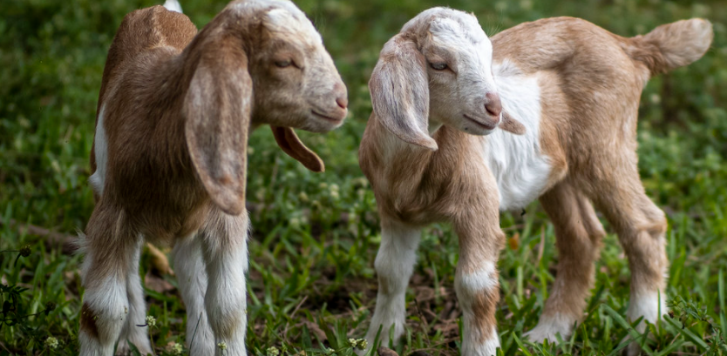
Importing Ovine and Caprine Germplasm from Scrapie Affected Countries
August 2024
Dr. Mary Kate Anderson
USDA APHIS VS Live Animal Imports
Dr. Linda Detwiler
USDA APHIS VS Ruminant Health Center

Slide 2
Scrapie Affected Countries from which Sheep and Goat Germplasm can be Imported into the United States
Ovine/Caprine Semen | Ovine/Caprine Embryos
Canada Iceland United Kingdom (Great Britain and Northern Ireland) European Union (Model Health Certificate) - Belgium (country specific certificate) - Spain (country specific certificate) | United Kingdom (Great Britain and Northern Ireland) Belgium
www.aphis.usda.gov/live-animal-import/sheep-goats-germplasm

Slide 3
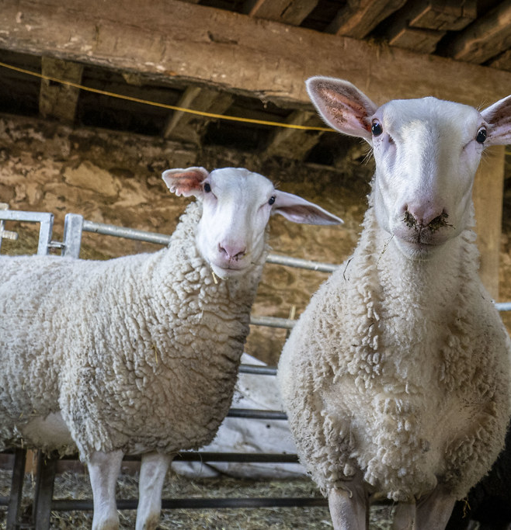
Eligible Receiving Premises in the United States
Imported semen/embryos - only eligible for transfer to females residing in eligible flocks/herds
Receiving flock/herd must have a Flock ID and Premises ID recorded in the National Scrapie Database (SCS SCR)
Importing APHIS-approved germplasm storage facility must have a Premises ID recorded in the National Scrapie Database (SCS SCR)
Artificial insemination/embryo transfer only to females residing in eligible flocks/herds

Slide 4
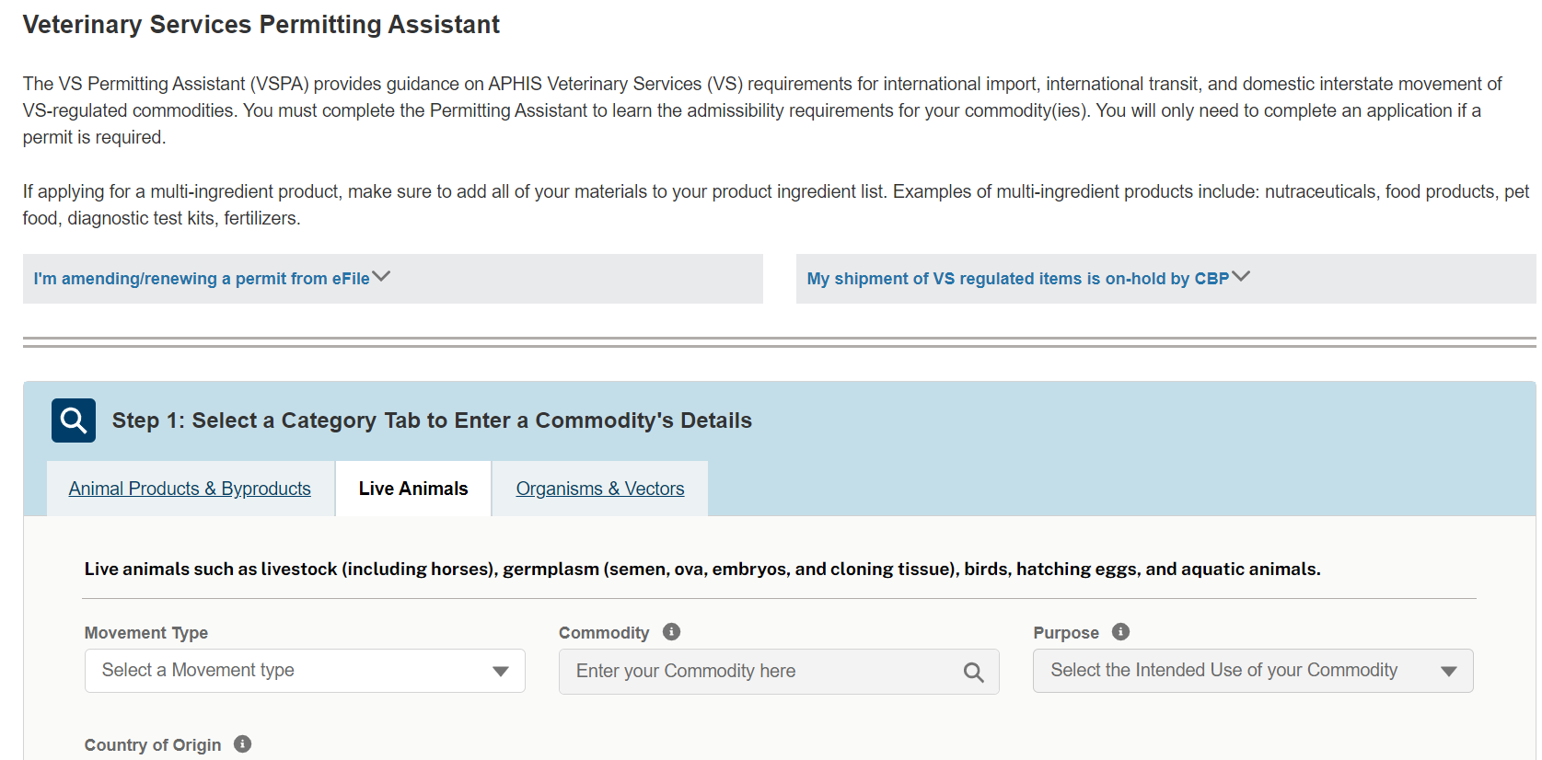
Requirements to Import
Import Permit
Apply for a permit electronically through APHIS eFile (VS Form 17-129)
Premises ID and if applicable flock ID recorded in National Scrapie Database
Confirmation of understanding of post-entry requirements
Importer must schedule inspection with APHIS port Veterinary Medical Officer at the port of entry prior to permit issuance

Slide 5
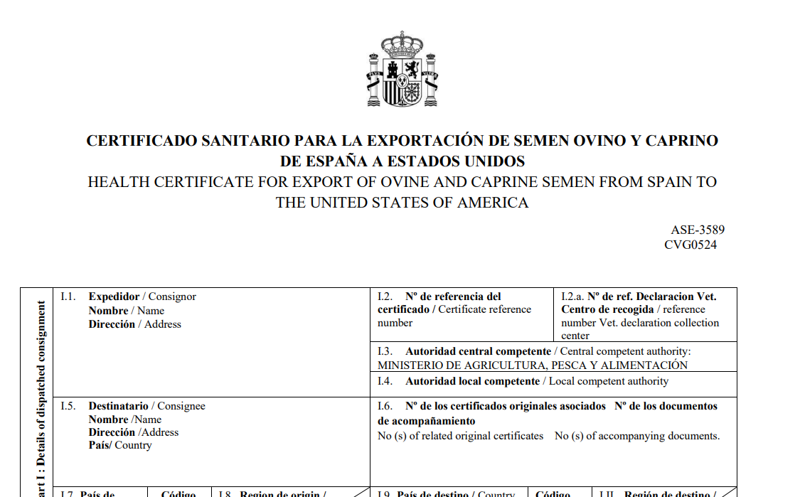
Requirements to Import (continued)
Export health certificate endorsed by the competent authority of the exporting country:
Donor animal testing dependent on animal disease status of the exporting country
Import eligibility based on scrapie resistant genotype of donor animal(s)
OR
Scrapie status of flocks/herds of birth/residency

Slide 6
Arrival at Port of Entry
APHIS port Veterinary Medical Officer (VMO) inspects tank and accompanying import documentation.
Check tank- seals are intact, no evidence of tampering; disinfection
Shipment in compliance:
Issue VS Form 17-30, shipment released
Shipment not in compliance:
Work with importer/broker to correct documentation errors (clerical errors, typos etc.)
Refusal and return to country of origin (broken seals upon arrival, major discrepancies etc.)

Slide 7
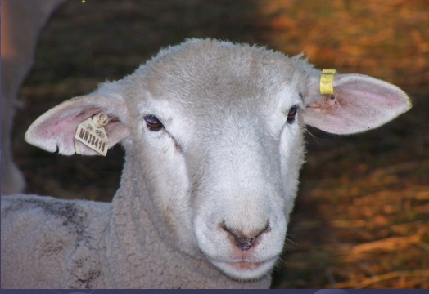
Post-Entry Requirements
Post-entry requirements pertain to all ovine/caprine germplasm imported from scrapie affected countries.
Requirements for:
Notification to APHIS confirming receipt and further distribution
Recordkeeping
Official identification of all offspring derived from imported germplasm
Regulatory Authority – 9 CFR Part 98

Slide 8
Reasoning for Post Entry Requirements
The United States is close to attaining scrapie freedom
There is insufficient data to conclude that the risk of transmitting scrapie via germplasm is negligible (see list of references)
We need to have records and identification for resulting offspring for traceability – imported vs. domestic case

Slide 9
EFSA Scientific Opinion on Risk of transmission of TSEs via semen and embryo transfer in small ruminants (sheep and goats)
ABSTRACT An assessment of the risk of transmission of Transmissible Spongiform Encephalopathies (TSEs) via semen and embryo transfer in small ruminants (sheep and goats) was performed… According to the data currently available, the risk of TSE transmission associated with semen and embryos collected from Classical Scrapie incubating sheep and goats ranges from negligible to low but the data are insufficient to conclude that such a risk is negligible. Because of the similarities between Classical scrapie and BSE pathogenesis in small ruminants, this statement is also to be considered valid for BSE. …Due to the use of animal-derived hormones and surgical devices for artificial insemination and embryo transfer procedures there is an inherent but unquantifiable risk of iatrogenic TSE transmission associated with these practices.
efsa.onlinelibrary.wiley.com/doi/abs/10.2903/j.efsa.2010.1429

Slide 10
Post-Entry Requirements
Import permittee must notify VS FiOps District Office within 10 business days confirming receipt of shipment and supply copy of permit
VS office enters information into National Scrapie Database and attach permit.
VS District Offices (Area Veterinarians in Charge) : www.aphis.usda.gov/ contact/animal-health

Slide 11
Post-Entry Requirements
Owner of all sheep or goat progeny resulting from semen/embryos imported from scrapie affected countries under 9 CFR Part 98 must:
Identify them at birth with permanent official ID,
ID cannot be removed except at slaughter and must be replaced if lost.
Maintain records linking the official ID to the imported semen or embryos including replacement tags.
Maintain records of any sale or disposition including the date of sale or disposition, the name and address of buyer, and the official ID.
Keep the required records for 5 years after the sale or death of the animal.
VS may view or copy records during normal business hours.

Slide 12
Post-Entry Requirements: Further Distribution
Before semen/embryos are moved for further distribution from the initial importing premises:
Permit holder must notify the receiving VS District Office.
The receiving VS District Office confirms that the flock has both a flock and premises ID.
District Office adds information and associated paperwork including a list of germplasm transferred to the National Scrapie Database. Records of sending and receiving premises are to be linked.

Slide 13
Post-Entry Requirements: Further Distribution
The importer of record must inform secondary recipients of necessary guidelines and required recordkeeping for use of the imported germplasm (in writing)
Must provide import permit to secondary recipients
Secondary recipients, and any other facility receiving the imported germplasm must notify the FiOps District Office in their State in writing (email) within ten (10) business days confirming receipt of the shipment and provide a copy of the import permit.

Slide 14
Post-Entry Requirements: Further Distribution
Sheep and goats from flocks/herds brought onto the importing or secondary premises for artificial insemination or embryo transfer must reside in a flock/herd with both a flock and premises identification listed in SCS Scrapie.
APHIS must receive the flock/herd identification information under the notification procedures outlined previously so staff can make sure progeny derived from the imported germplasm meet requirements and that we can link data in SCS Scrapie.
Identification and recordkeeping requirements are as stated above.

Slide 15
Imported Germplasm and Scrapie Free Flock Certification Program (SFCP) Flocks/Herds
Status of imported semen does not affect the status of a receiving SFCP flock/herd provided the donors are NOT scrapie positive, scrapie suspect, high risk or genetically susceptible exposed animals.
Embryos may be used without a reduction in status or status date if they are legally imported into the United States for unrestricted use and if they meet U.S. import requirements.

Slide 16
For More Information: www.aphis.usda.gov/live-animal-import/sheep-goats-germplasm

Slide 17
Scrapie References
Links to scientific publications of transmission studies regarding semen and embryos:
PrP(Sc) detection and infectivity in semen from scrapie-infected sheep
Prion protein is secreted in soluble forms in the epididymal fluid and proteolytically processed and transported in seminal plasma
Prevention of scrapie transmission in sheep, using embryo transfer - PubMed (nih.gov)
Failure to transmit scrapie infection by transferring preimplantation embryos from naturally infected donor sheep
Observations on the transmission of scrapie in experiments using embryo transfer

