Slide 1
Scrapie Final rule & revised NSEP Standards
Key things Market operators need to know

Slide 2
This is a summary. The rule and program standards should be referred to for full context.
The Scrapie final rule and the revised NSEP standards (nseps) are effective April 24th – 30 days after publication

Slide 3
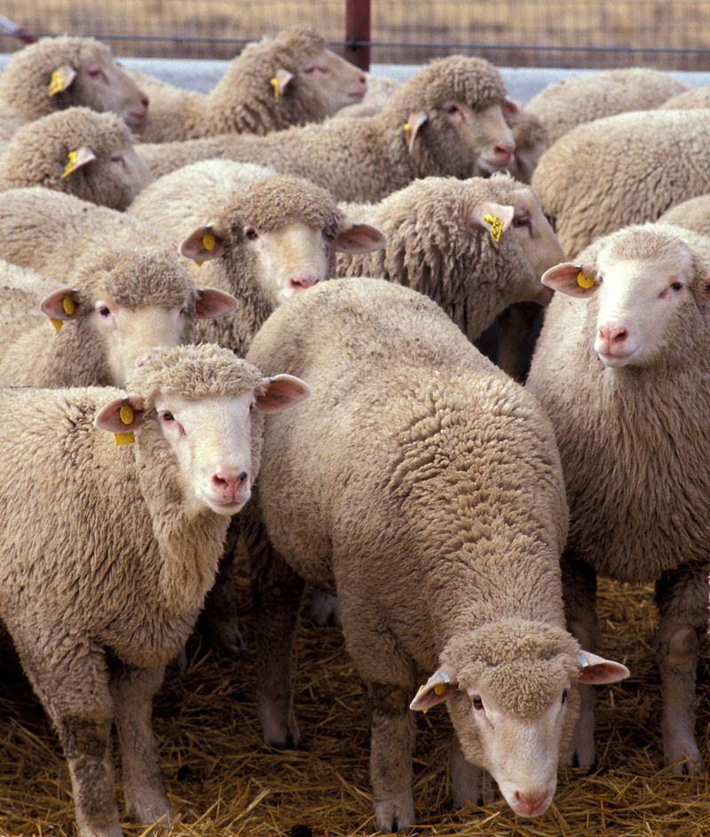
General ID and movement
o Federal ID and recordkeeping requirements are now the same for sheep and goats; however, the allowed state exemptions for consistent states for sheep and goats in intrastate commerce in part 79.6 didn’t change.
o We clarified what is considered interstate commerce to include animals sold, disposed of, acquired, exhibited, transported, received for transportation, offered for sale or transportation, loaded, unloaded, or otherwise handled in interstate commerce or commingled with such animals or loaded or unloaded at a premises or animal concentration point (including premises that exhibit animals) where animals are received that have been in interstate commerce or from which animals are moved in interstate commerce. So this puts most sheep and goats that are moving under the federal requirements.

Slide 4
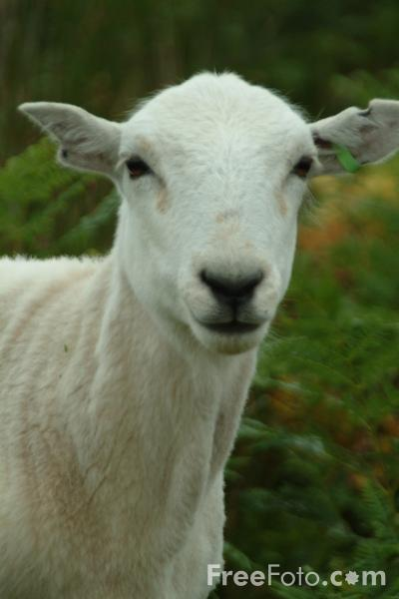
General ID and movement cont.
o Sheep or goats moving in slaughter channels or moving without official ID must have an owner/hauler statement with group/lot identification. We are working on getting a template posted for producers to use. Owners can provide the required information without using our template. The following is what needs to be on an owner/hauler statement:
The name, address, and phone number of the owner and, if different, the hauler;
The date the animals were moved;
The flock identification number or PIN assigned to the flock or premises of the animals;
If moving individually unidentified animals or other animals required to move with a group/lot identification number, the group/lot identification number and any information required to officially identify the animals;
The number of animals;
The species, breed, and class of animals. If breed is unknown, for sheep the face color and for goats the type (milk, fiber, or meat) must be recorded instead; and
The name and address of point of origin, if different from the owner’s address, and the destination name and address.
For animals in slaughter channels the destination must be a slaughter establishment, restricted animal sale, restricted livestock facility, terminal feedlot to which the animals are being moved, or an individual for personnel consumption and must include a statement that the animals are in slaughter channels.
Signature of owner or hauler

Slide 5
Owner Statement example For sheep/goats deliver to a market by the owner of the flock of origin (if not delivered by the owner the hauler and flock of origin information would also need to be included):
Bob Doe
123 East ST
Wood, MI 12345
876-987-0987
4-19-19
MI3187, Lot MI3187-041919-1
10 Blackface cull ewes, 6 meat nannies
Happy Valley livestock
4787 Free Ln.
Tree, MI 46678
These animals are in slaughter channels
Bob Doe

Slide 6
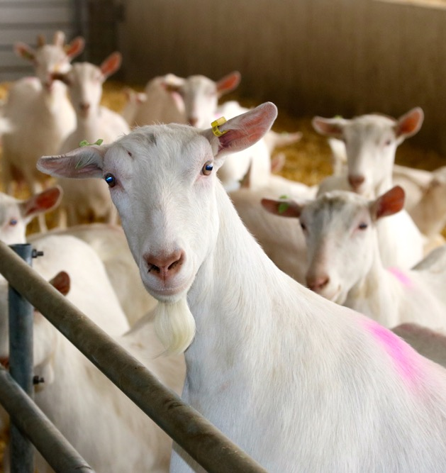
Markets
Any sheep or goat arriving at or leaving a market that doesn’t meet the requirements to move as a breeding animal must be accompanied by an owner/hauler statement provided by the seller and buyer. Markets must keep copies or the information in the statement. Markets may find it more efficient to include the required information on their intake sheets and bills of sale rather than retaining copies of the statements.
If an owner doesn’t provide the statement as required the market is in compliance if they collect and record the required information from the seller/buyer
Any sheep or goat (excluding wethers under 18 months of age) arriving at market without official ID must have an owner/hauler statement and if sold unrestricted at any age or at over 18 months of age for slaughter must be officially identified by the market.
Slaughter lots of animals that are all from the same breeding flock that are over 18 months may move through a slaughter only sale with group lot ID rather than eartags if buyer agrees to maintain the lot as group through slaughter; this or back tags are probably the best way to address mature range buck goats moving direct to slaughter.

Slide 7
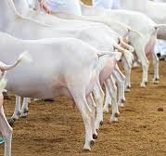
Markets cont.
Slaughter lots of animals that are from different or the same breeding flock that will be slaughtered at under 18 months may move through a slaughter only sale with group lot ID rather than eartags if buyer provides an owner/hauler statement listing the recognized slaughter establishment, a slaughter only sale, an individual for immediate slaughter for personal use or the terminal feedlot to which the animals will be moved.
Sheep and goats that are individually officially identified do not require an owner hauler statement unless they don’t meet the requirement to move as breeding animals. For example if they cross a state line without an ICVI because they are moving for slaughter or feeding for slaughter or to a restricted sale they need an owner hauler statement indicating they are in slaughter channels.
Sheep and goats (excluding wethers) not moving with a slaughter animal owner hauler statement that are going out-of-state require an ICVI.
Owners can move non-slaughter sheep/goats from out-of-state without an ICVI or official ID only to a federally approved market (if they don’t have official ID they must have an owner/hauler statement and be tagged by the market). An ICVI and official ID is required to move such animals interstate to a non-federally approved market.

Slide 8
Markets cont.
The rule acknowledges a State’s right to limit the types of tags that may be applied by markets and others who don’t own breeding flocks to slaughter only tags as was requested by a state in the comments to the rule.
Markets may only use backtags as official ID for direct to slaughter movements of earless animals and when agreed to by the SAHO and AVIC in a market or compliance agreement mature buck goats determined too dangerous to eartag. Other uses of back tags for direct to slaughter movements may be approved on a case by case basis by AVIC, SAHO and commodity staff were traceability can be maintained. Markets are encourage to continue to use backtags as secondary ID.
Sheep or goats that are only identified with an official tattoo or electronic implanted ID must be eartagged if moved through a market unless it is a special breeding stock sale where the tattoos and EIDs will be documented.
Under the rule VS may require a market to submit tagging records to VS. This will only be use when a compliance issue has been identified or to do a record inspection when onsite inspection is impractical. Burden to the market will be considered when making such requests.

Slide 9
Backtags
Compliance agreements
Backtag use as the only official ID has been further limited to direct to slaughter only for earless animals and when agreed to by the SAHO and AVIC in a market or compliance agreement mature buck goats determined too dangerous to eartag. For some markets it may also be desirable to develop a sole source group lot system with markets handling rank slaughter buck goats to address safety concerns NSEPS pg. 54.
Compliance agreements are allowed by the rule, so if a deviation is agreed to with a market, dealer or slaughter plant to enhance animal traceability it must be formalized in a compliance agreement. One of the main purposes of a compliance agreement is to keep a market, dealer or slaughter plant form getting a warning or penalty as a result of an IES investigation where the market, dealer or slaughter plant assisted VS in identifying the violation and the seller or buyer is primarily at fault.
Tattoo or EID use as official ID
Multiple tags
Tattoo or EID use as official ID. Changed to require a tag for movements to slaughter or through a livestock market without transfer of registration papers.
Multiple tags: rule limits the number of official tags similar to part 86 that can be applied to an animal (i.e. one RFID, one Flock ID, and one other type of tag if it was applied first unless a pair set was used with the same ID number)

Slide 10
There is no change to when an ICVI is required.
Slaughter Channels
Slaughter channels have been limited to: any animal that is sold, transferred, or moved either directly to or through a restricted animal sale or restricted livestock facility to an official slaughter establishment that is under Food Safety and Inspection Service (FSIS) jurisdiction per the Federal Meat Inspection Act (FMIA) or under State inspection that FSIS has recognized as at least equal to Federal inspection or to a custom exempt slaughter establishment as defined by FSIS (9 CFR 303.1) for immediate slaughter or to an individual for immediate slaughter for personal use or to a terminal feedlot.

